Slide 1



Bariatric surgery training in the italian system
Calabrese Pietro
Chirurgo generale
Dottorando Università degli Studi di Napoli Federico II

Slide 2



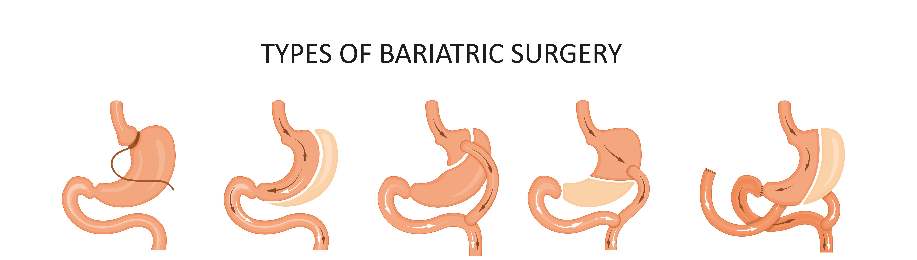

Bariatric surgery training in the Italian System
Background
Bariatric surgery has become one of the fastest-growing surgical specialties worldwide
Proper training is crucial to ensure patient safety and surgical competence
International societies (IFSO, ASMBS) have proposed structured training models and minimum requirements
In Italy standardized educational pathways in bariatric surgery are still heterogeneous
Several initiatives exist (SICOB)
Data on training experiences remain limited

Slide 3
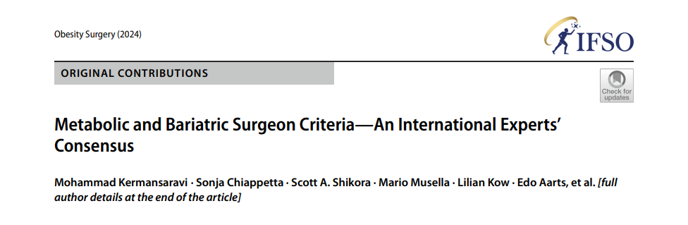

Bariatric surgery training in the Italian System
IFSO Consensus 2024
Metabolic and Bariatric Surgeon Criteria
Conducted using the Delphi method
89 expert bariatric surgeons
Surgeons from 42 countries
Consensus (≥70%) was reached on 29 out of 30 statements defining the requirements for obtaining operative privileges in bariatric/metabolic surgery

Slide 4
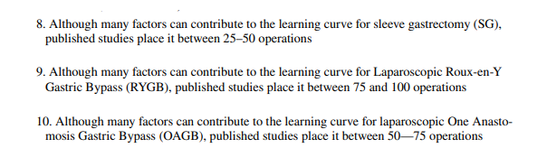
Bariatric surgery training in the Italian System
Statements include:
Completion of a dedicated bariatric/metabolic fellowship
A minimum number of procedures to achieve competence (learning curves):
25–50 Sleeve Gastrectomy
50–75 One-Anastomosis Gastric Bypass (OAGB)
75–100 Roux-en-Y Gastric Bypass (RYGB)
Minimum 2-year postoperative follow-up for patients
Active participation in a multidisciplinary team and management of complications
Use of national or international databases for outcome monitoring

Slide 5
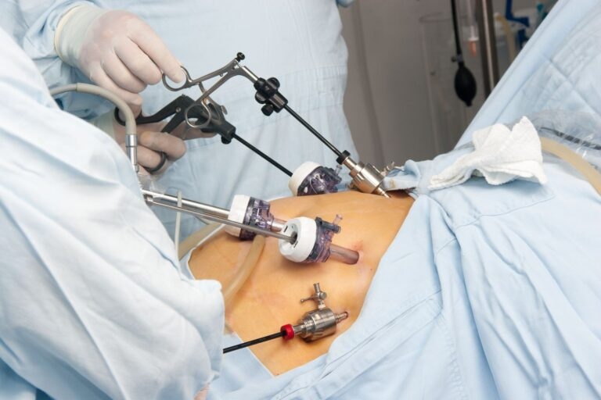

Bariatric surgery training in the Italian System
But…
What is the current
status of bariatric
surgery training in
the Italian system?

Slide 6
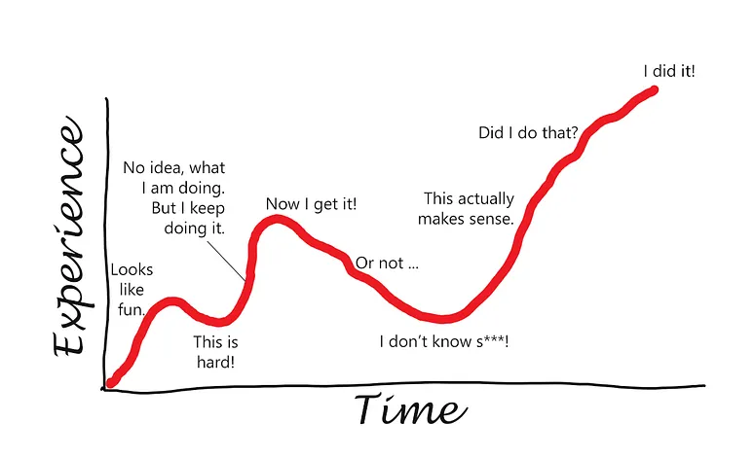

Bariatric surgery training in the Italian System
Aim
To evaluate the current status of bariatric surgery training in Italy by:
Describing residents’ and surgeons’ training experiences
Identifying gaps and perceived barriers
Exploring opportunities for improvement
Notes:
“Our goal was to get a real snapshot of bariatric surgery education in Italy — what works, what’s missing, and how young surgeons perceive their training.”

Slide 7


Bariatric surgery training in the Italian System
Methods
Online questionnaire (SurveyMonkey)
Surgical residents and young surgeons under 45 years
41 items covering demographics, training exposure, experience and perceptions
Distributed nationally
Total respondents: 110 (first month)

Slide 8
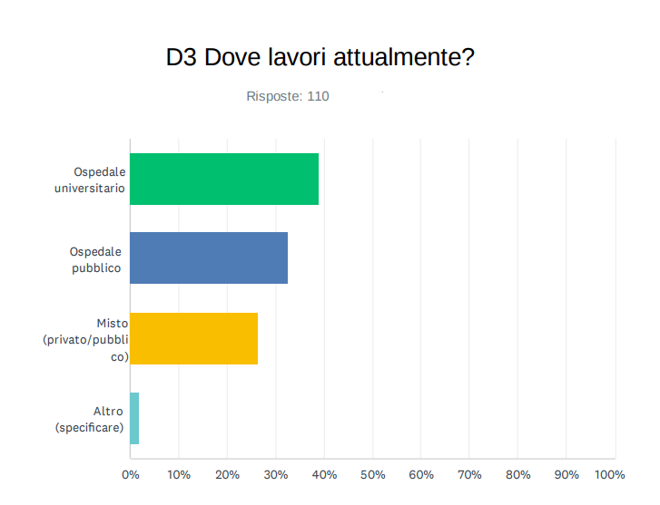
Bariatric surgery training in the Italian System
Respondents’ Profile
Current workplace
39% University Hospital
33% Public Hospital
27% Mixed/Private
Who Answered the Survey?
“Good representation of different types of centers”

Slide 9
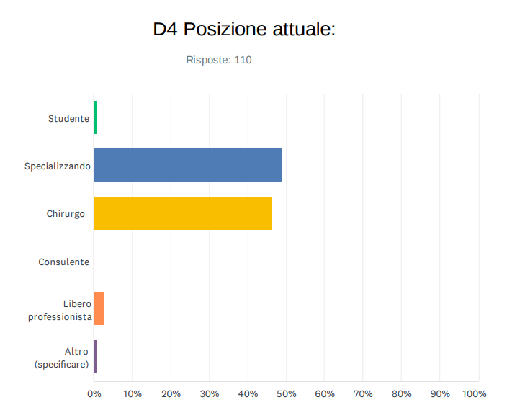
Bariatric surgery training in the Italian System
Respondents’ Profile
Current position
45% Residents
50% Surgeons
5% Others
Who Answered the Survey?
“Good overview of both sides of the educational process”

Slide 10
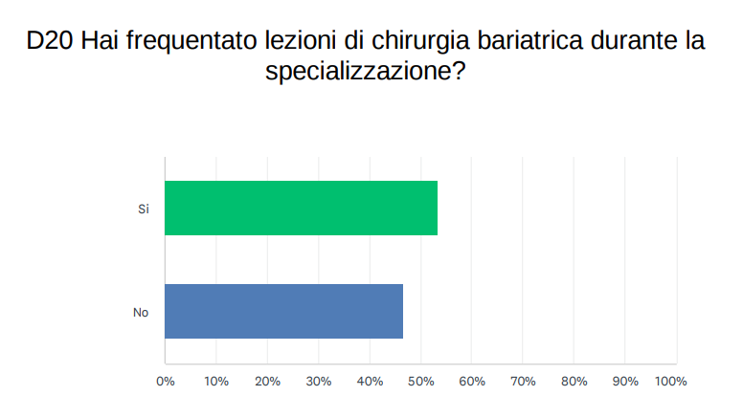
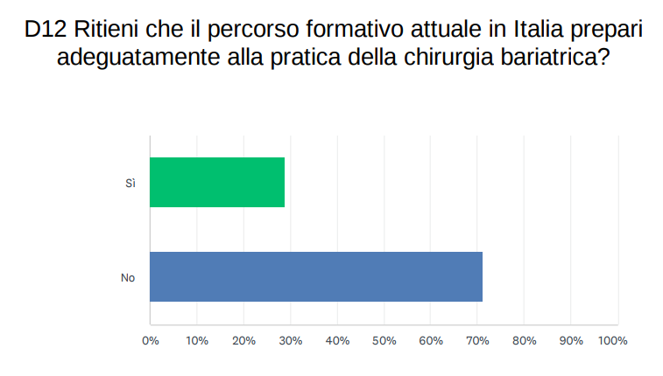
Bariatric surgery training in the Italian System
Training Exposure
53% received no formal bariatric lectures during residency
73% attended external courses or congresses
72% felt the current residency program is inadequate
Theoretical Exposure During Residency

Slide 11
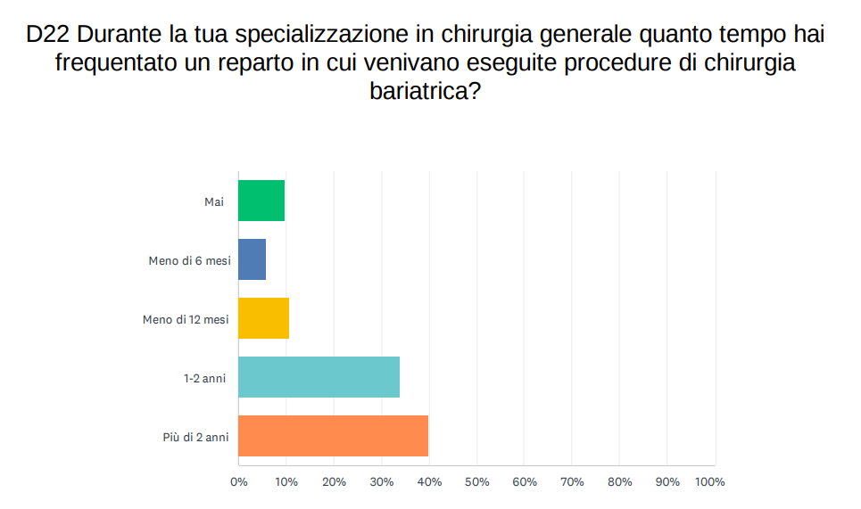
Bariatric surgery training in the Italian System
Practical Exposure During Residency
Training Exposure
73% spent >1 year in a bariatric unit

Slide 12
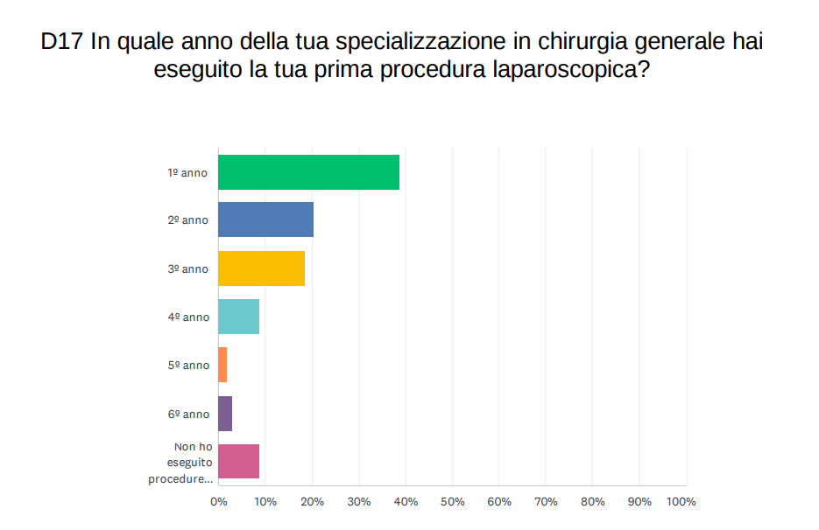
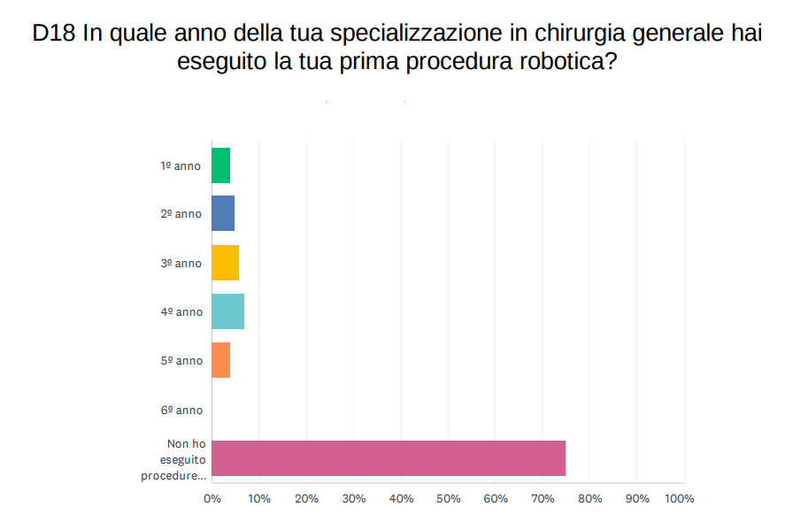
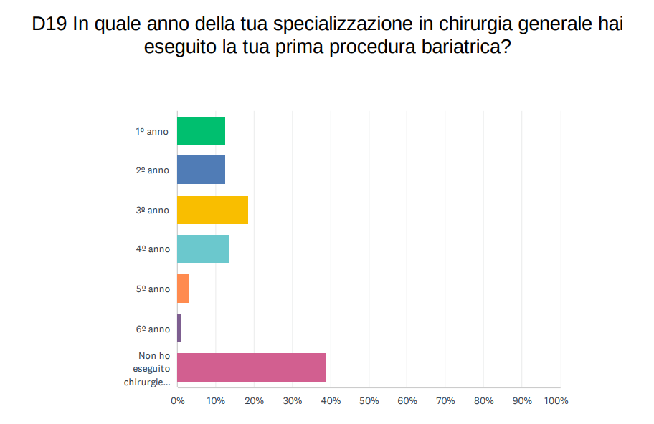
Bariatric surgery training in the Italian System
Practical Exposure During Residency
Practical Exposure
“39% performed their first laparoscopic procedure during the first year of residency.”
“78% during the first three years”
“79% never performed a robotic procedure during residency.”
“60% performed a bariatric procedure during residency.”
Notes:
“Although many residents assist in surgery, hands-on exposure remains limited — most have performed only a few cases independently, and very few have access to robotic or endoscopic training.”

Slide 13
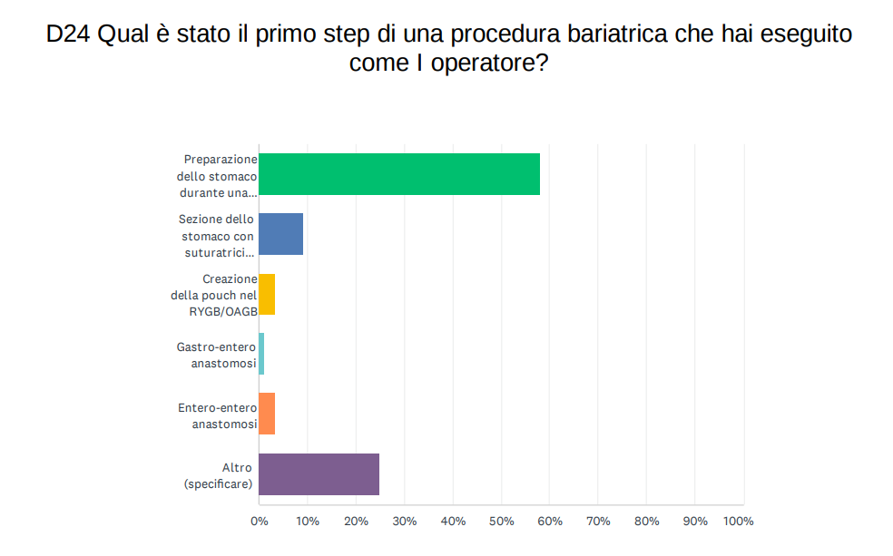
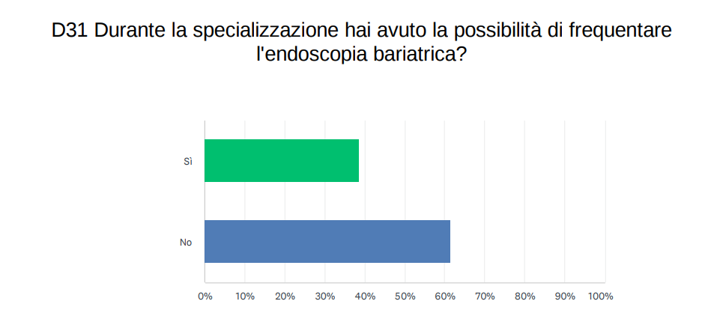
Bariatric surgery training in the Italian System
Practical Exposure
Most common first step:
Stomach preparation during sleeve gastrectomy
46% performed a complete laparoscopic sleeve gastrectomy
40% had access to bariatric endoscopy
Practical Exposure During Residency

Slide 14
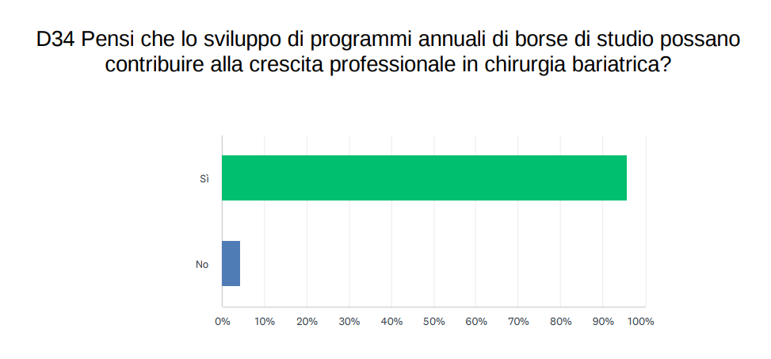
Bariatric surgery training in the Italian System
Barriers and Needs
How can we improve?
“96% believe scholarships or fellowship programs would improve training”

Slide 15
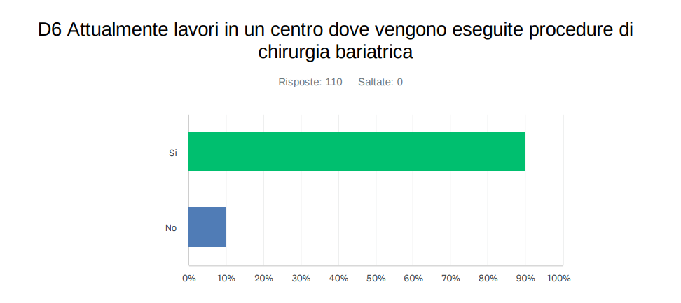

Bariatric surgery training in the Italian System
Limitations of the Survey
93% of respondents work in bariatric centers
Possible selection bias toward surgeons already involved in the field
May overestimate exposure and opportunities compared to the national average

Slide 16

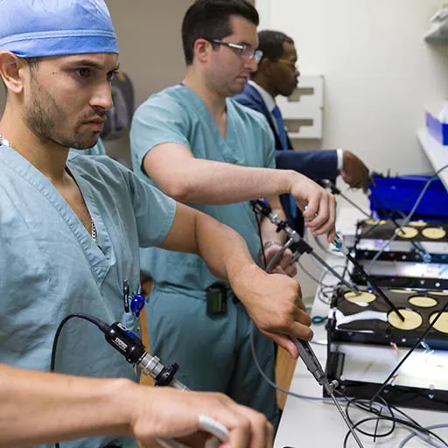

Bariatric surgery training in the Italian System
Conclusions
Bariatric training in Italy remains heterogeneous
Theoretical exposure during residency is often insufficient
National coordination and structured fellowship programs are needed
Results support SICOB’s role in standardizing bariatric education

Slide 17
Bariatric surgery training in the italian system
Grazie per l’attenzione

